Slide 1
Currency Convertor
Lab 06

Slide 2
To complete this lab
PC
Unity
GitHub Desktop Client
GitHub account
Microsoft office application
Group of 2 students – (Student A and Student B)

Slide 3
Step 1: Setting up
Create a new repo name: Lab06
Create new Unity Project, 00_HanselKoh_Lab06
Commit and push your progress to GitHub during your development

Slide 4
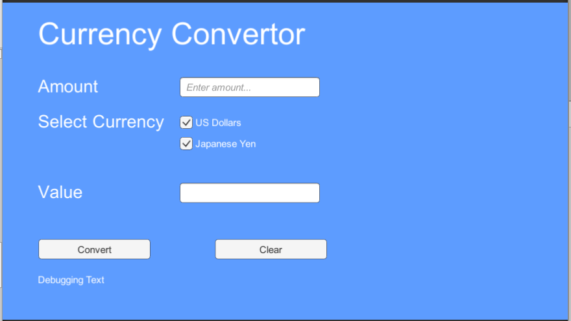
Step 2: Design a SCENE
You are to create a scene for the calculator in Unity
Using UI component such as
Text
Input Field
Button
Toggle

Slide 5
Step 2: Design a SCENE
You are to create a scene for the calculator in Unity
Using UI component such as
Text
Input Field
Button
Toggle
Sno | UI Type | GameObject Name | Display text | Remarks
1 | Text | TextAmount | Amount
2 | Text | TextSelectCurrency | Select Currency
3 | Text | TextValue | Value
4 | Input Field | InputAmount
5 | Input Field | InputConvertedAmt |  | Read Only
6 | Button | BtnConvert | Convert
7 | Button | BtnClear | Clear
8 | Toggle | ToggleUSdollars | US Dollars
9 | Toggle | ToggleJapaneseYen | Japanese Yen
10 | Text | DebugText | Debugging Text

Slide 6
Step 3: Reference
Write a CalculatorScript to perform the required conversion of different currency
Use the below snippet to get or set values for Toggle and InputField
Currency conversion rate
SGDUSD: 0.74
SGDJPY: 82.78
Get / Set of toggle
toggleUSDollar.isOn = false;
Get / Set of Input Field
inputConvertedAmount.text = "$" + (amount + SGDUSD_rate);
Convert Text to float
float amount = float.Parse(inputAmount.text);

Slide 7
Step 5: Test and add more features
Test and ensure the currency conversion works
Debug application if any errors/bugs
Clear button resets amount, converted amount and toggles.
Implement handle exception when invalid value for the amount. Display “Please enter a valid amount”. Hint: Try/Catch
Test and debug application, ensure all functionalities works as intended.
Save your project

Slide 8
Part 6: Adding a Collaborator
Add your assigned classmate as collaborator to your repository
Add 00-HanselKoh as collaborator as well

Slide 9
PART 7: Collaborator Contribute
Invited collaborator will receive an email
Click the link provided in your email to accept the invitation
Clone the repository to your local GitHub client
Student A clones the repository created by Student B
Student B clones the repository created by Student A
File > Clone Repository > URL

Slide 10
STEP 8: Update project
To be done by the collaborators…
Add the following feature(s) to your classmates’ repository
Update the currency convertor with following conversion
1 SGD converts to 3.08 Malaysian RM
1 SGD converts to 0.63 European EUR
1 SGD converts to 881.54 Korean KRW
1 SGD converts to 20.73 Taiwan TWD
Add the following
Commit and Push your progress while coding new features!
Sno | UI Type | GameObject Name | Display text | Remarks
1 | Toggle | ToggleMalaysianRM | Malaysian Ringgit
2 | Toggle | ToggleEuropeanEUR | European Euro
3 | Toggle | ToggleKoreanKRW | Korean Won
4 | Toggle | ToggleTaiwanTWD | Taiwan Dollar

Slide 11
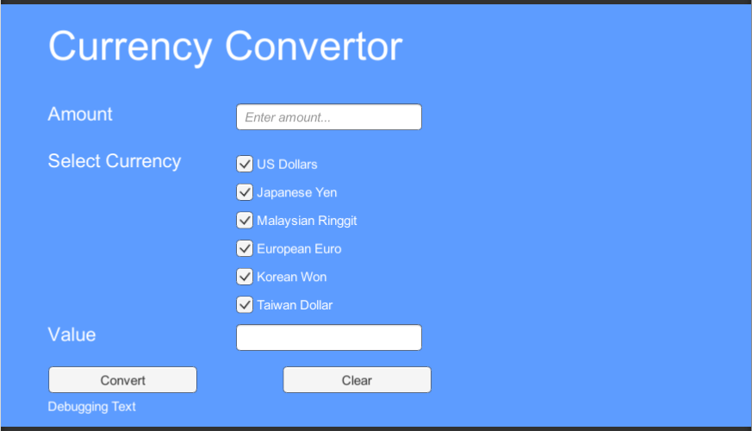
Reference

Slide 12
Step 9: Owner test the updates
After collaborators have integrated the additional features
Repository owner to perform integration testing of the convertor
Refer to the next slides for the template of integration test cases
Create a minimum of 10 test cases to perform integration testing for currency conversion application
Compare yours with the given below
https://simmer.io/@itegpd/~0598aa49-4edd-f695-3686-ec4661e2a9da

Slide 13
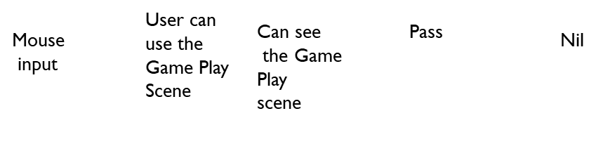
integration testing Example
Test case ID | Description | Input | Expected Result | Actual Result | Pass/Fail | Remarks
1 | Verifying the interface link, between Main scene and Game Play scene

Slide 14
Step 10: integration testing
Test case ID | Description | Input | Expected Result | Actual Result | Pass/Fail | Remarks
1
2
3

Slide 15
Step 10: integration testing
Test case ID | Description | Input | Expected Result | Actual Result | Pass/Fail | Remarks
4
5
6

Slide 16
Step 10: integration testing
Test case ID | Description | Input | Expected Result | Actual Result | Pass/Fail | Remarks
7
8
9
10

Slide 17
Step 11: Submission
Zip Unity Project as 00_HanselKoh_Lab06
Save this slides in pdf version
(Submit updated slides: 13, 14, 15. Please delete other slides)
Include your Git URL in MyConnexion
Upload to MyConnexion

